Slide 1

Welcome to SFSM
Parents’ Forum:
Addition & Subtraction

Slide 2

The importance of
mathematical vocabulary
Units = ones
Borrow/Carry/Steal = exchange

Slide 3
Subtraction

Slide 4
Children begin to set out in columns and record TO – TO as column subtraction:
2 8
-1 2
1
6
Year 3

Slide 5
Children continue to set out in columns and record TO – TO as column subtraction with exchange:
2
3 3
-1 4
1
exchange
1
9
Year 3

Slide 6
Children continue to set out in columns and record HTO – TO as column subtraction:
3 2 4
- 1 2
3
1
2
Year 3

Slide 7
Children continue to set out in columns and record HTO – TO as column subtraction with exchange:
2
1 3 6
- 1 8
1
exchange
1
1
8
Year 3

Slide 8
Now it’s your turn to have a go, using the dienes and recording on the whiteboards…
No exchange:
45 - 23
289 - 76
With exchange:
34 - 17
145 - 26
Year 3

Slide 9
Children continue to set out in columns and record HTO – TO as column subtraction with exchange:
1
2 3 6
- 7 3
1
1
6
3
exchange
Year 3

Slide 10
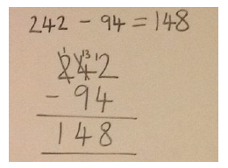
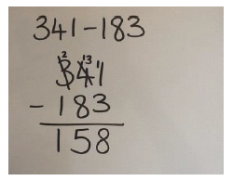
Children continue to set out in columns and record HTO – TO and HTO - HTO as column subtraction with exchange across more than one place value column:
Year 3

Slide 11
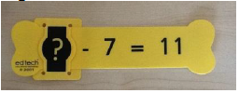
Children will solve one and two-step subtraction problems, including missing numbers.
?
11
7
Year 3

Slide 12
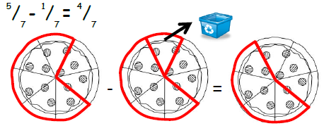
Children practise subtracting fractions with the same denominator (within one whole):
Year 3

Slide 13
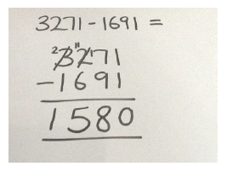
Children will subtract numbers with up to 4 digits, using formal written method.
Year 4

Slide 14
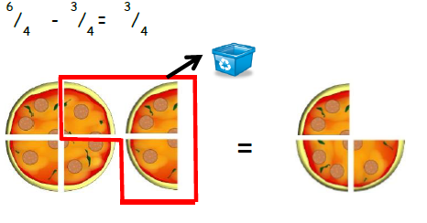
Children will continue subtracting fractions with the same denominator (beyond one whole):
Year 4

Slide 15
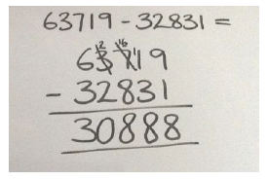
Children will subtract numbers with more than 4 digits, using formal written method.
Year 5

Slide 16
Children will subtract decimal numbers with the same number of decimal places:
3
1
0.1
1
0.01
4.6 3
- 2.9 1
1
0.1
1
1
0.1
0.01
0.1
0.1
0.01
exchange
0.1
.
1
7
2
0.1
0.1
0.1
0.1
0.1
0.1
0.1
0.1
0.1
0.1
Year 5

Slide 17
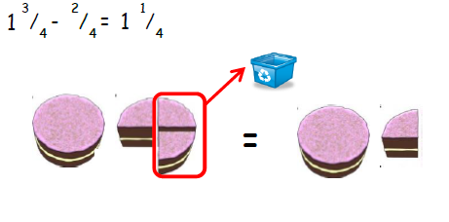
Children subtract fractions where calculations exceed one as a whole number:
Year 5

Slide 18
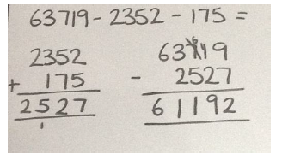
Children will subtract several numbers of increasing complexity and be taught to combine these so that the subtraction can be carried out:
Year 6

Slide 19
Children will subtract decimal numbers with a differing number of decimal places:
2
3.2 1
1.8 0
1
Zero is used as a place holder.
0
.
1
4
1
Year 6

Slide 20
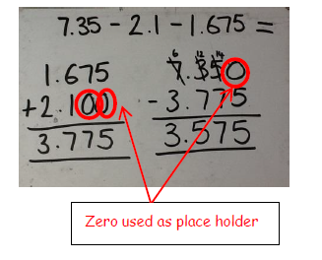
Children will subtract several decimal numbers with a differing number of decimal places:
Year 6

Slide 21
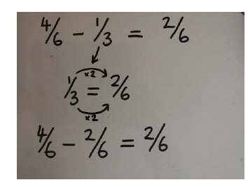
Children will subtract mixed numbers and unlike fractions, using the concept of equivalent fractions:
Year 6

Slide 22
Addition

Slide 23

Children set out HTO + O in columns and record as column addition:
3 4 5
+ 3
3
4
8
Year 3

Slide 24
Children set out HTO + TO in columns and record as column addition (no exchange):
3 4 5
+ 2 3
3
6
8
Year 3

Slide 25
Children set out HTO + TO in columns and record as column addition with exchange:
3 4 6
+ 2 5
3
7
1
1
exchange
Year 3

Slide 26
Children set out HTO + TO in columns and record as column addition with exchange:
3 2 4
+ 9 1
4
1
5
1
exchange
Year 3

Slide 27
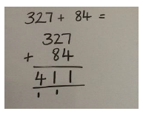
Children set out HTO + TO in columns and record as column addition with exchange across two place value columns:
Year 3

Slide 28
Children set out HTO + TO in columns and record as column addition with exchange across two place value columns:
Year 3

Slide 29
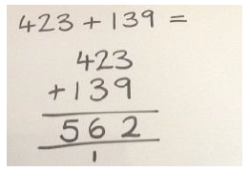
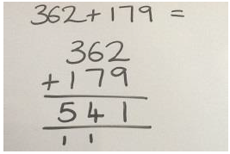
Children set out HTO + HTO in columns and record as column addition:
Exchange across tens boundary
Exchange across tens & hundreds boundary
Year 3

Slide 30
Now it’s your turn to have a go, using the dienes and recording on the whiteboards…
No exchange:
123 + 36
321 + 123
With exchange:
131 + 29
243 + 157
Year 3

Slide 31
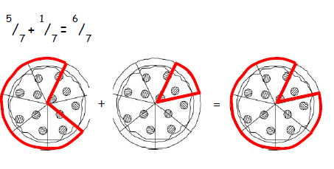
Children practise adding fractions with the same denominator (within one):
Year 3

Slide 32
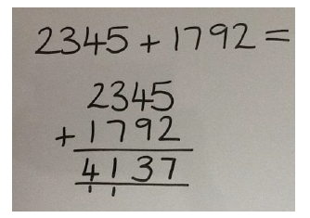
Children add numbers with up to 4 digits, using formal written method:
Year 4

Slide 33
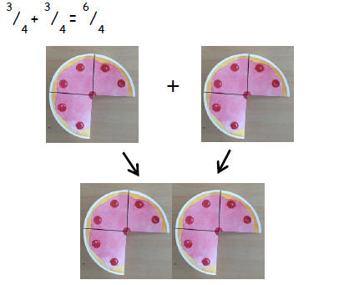
Children will continue adding fractions with the same denominator (beyond one whole):
Year 4

Slide 34
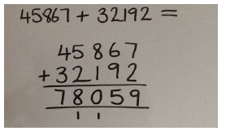
Children will add numbers with more than 4 digits, using formal written method.
Year 5

Slide 35
Children will add decimal numbers with the same number of decimal places:
0.01
1
0.01
0.01
3.1 7
+ 4.2 5
1
0.1
0.01
1
0.01
0.01
0.01
.
7
4
2
1
1
0.1
0.01
1
0.01
1
0.1
0.01
1
0.01
0.01
Year 5

Slide 36
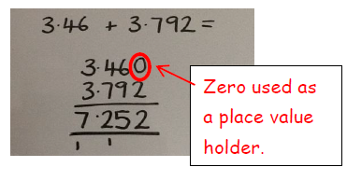
Children will add decimal numbers with a differing number of decimal places:
Year 5

Slide 37
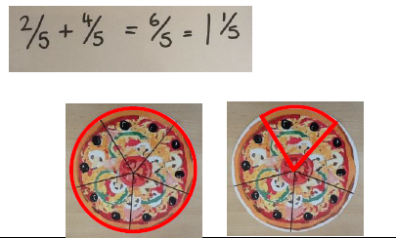
Children subtract fractions where calculations exceed one as a whole number:
Year 5

Slide 38
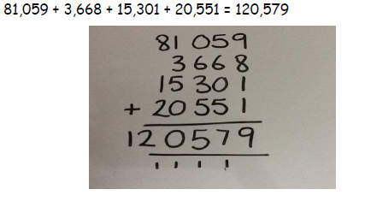
Children will add several numbers of increasing complexity:
Year 6

Slide 39
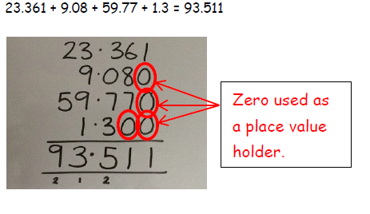
Children will add several decimal numbers with a differing number of decimal places:
Year 6

Slide 40
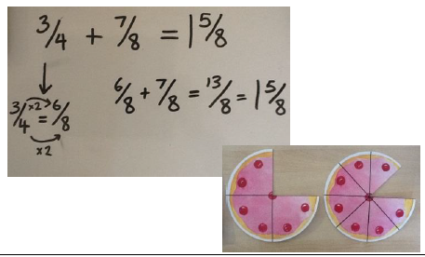
Children will add mixed numbers and unlike fractions, using the concept of equivalent fractions:
Year 6

Slide 41
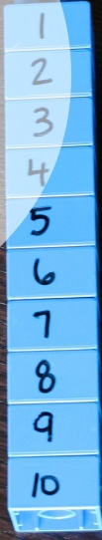

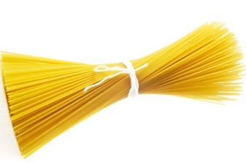
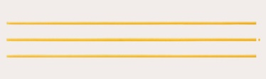
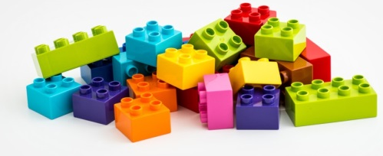
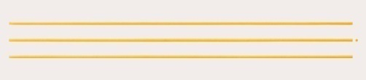
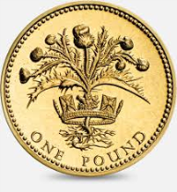
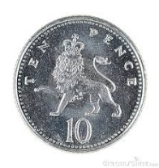
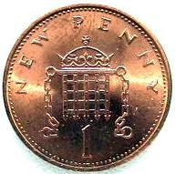
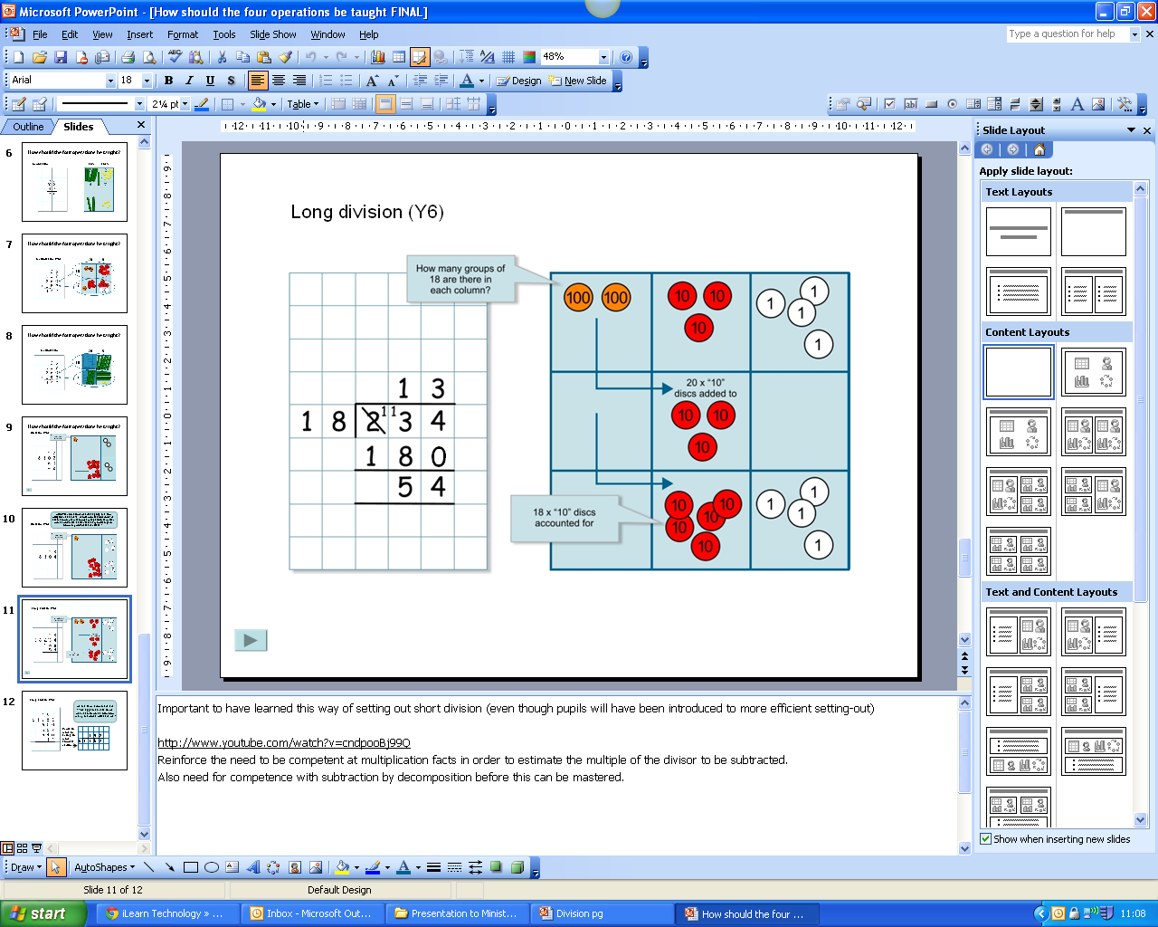
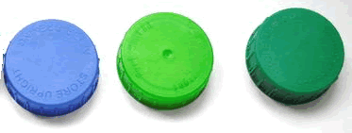
What can I use at home?
100
10
1

Slide 42
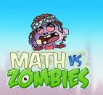
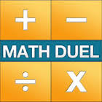


Useful apps and websites for calculation:
Maths Vs Zombies
Math Duel
TT Rock Stars
6 Numbers
www.topmarks.co.uk
www.mathplayground.com
www.crickweb.co.uk

