Slide 1


Supporting Reading
at Home

Slide 2


Slide 3

Notes:
Google chrome- Ipads, smart phones devices

Slide 4


Slide 5


Slide 6


Slide 7


Slide 8


Slide 9


Slide 10
Log on details
User name: FirstLast
Password: lnsfm
School ID: 66tp
Children should have this written in their diary.

Slide 11


Slide 12
Logging on
Enter your log in details that are on your bookmark
Only one person can log on with these details at a given time

Slide 13
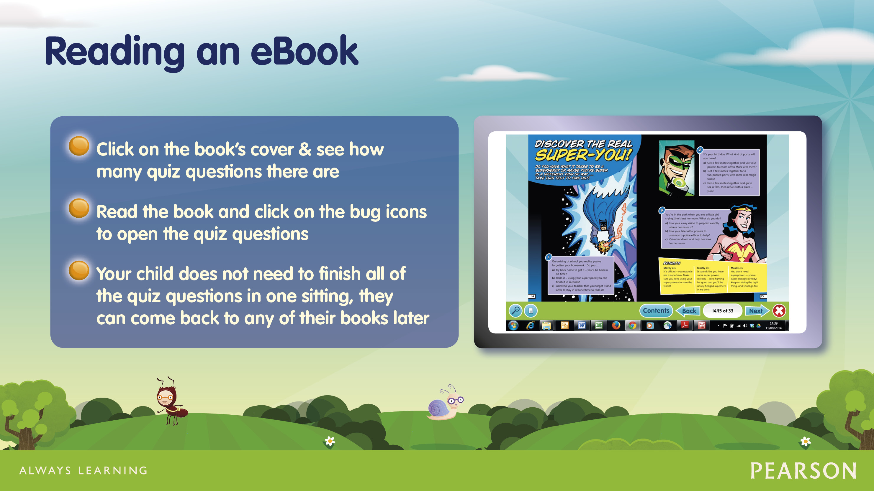

Slide 14
Activity 1:
Click on ‘My Stuff’
Click on the book ‘Dino-soaring’
After reading the first page- press the first bug icon
Complete the question and then press done
Click the back to the book icon
When the children have answered a question the bug will close its eyes
Read the rest of the book and answer the questions by clicking on the rest of the bugs
Click the x to close the book
To show the children have answered all the questions the bugs will be ’asleep’

Slide 15
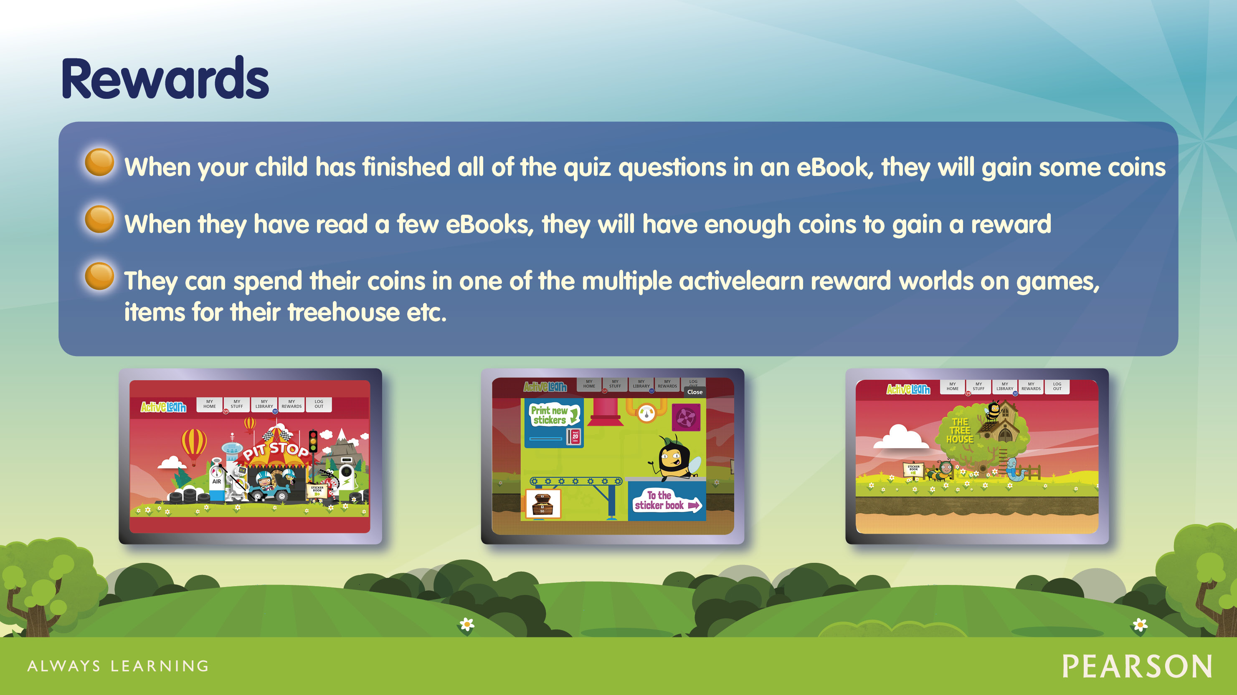

Slide 16
Activity 2:
Click on My Rewards
Explore the games area- play some of the 1 coin games

Slide 17
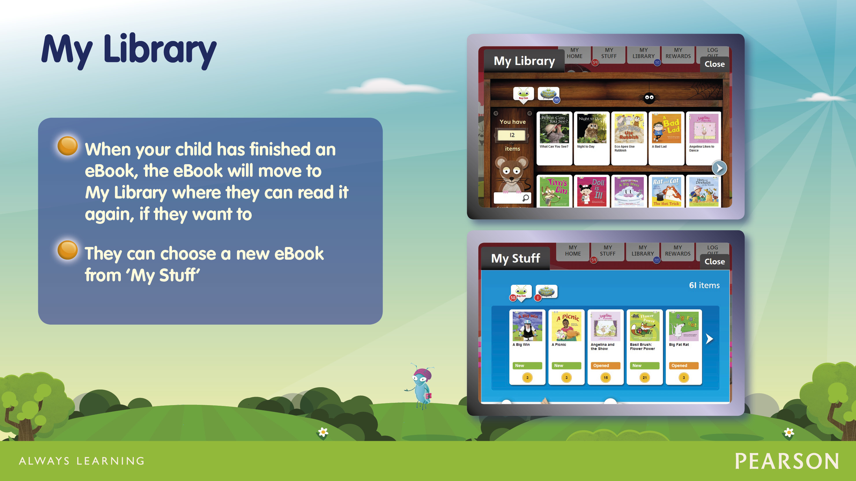

Slide 18


Slide 19
Teacher’s view
Notes:
Assessment-pupil profiles- change class to parents’ forum
Assessment- activity reporting-bug club
We can check how many books have been completed by the each child.
Home- Recent activity on screen

Slide 20


