Slide 1

Welcome to SFSM
Parents’ Forum:
Calculation Policy

Slide 2

The importance of
mathematical vocabulary
Units = ones
Borrow/Carry/Steal = exchange

Slide 3
Division

Slide 4
Here watch video on
website.

Slide 5
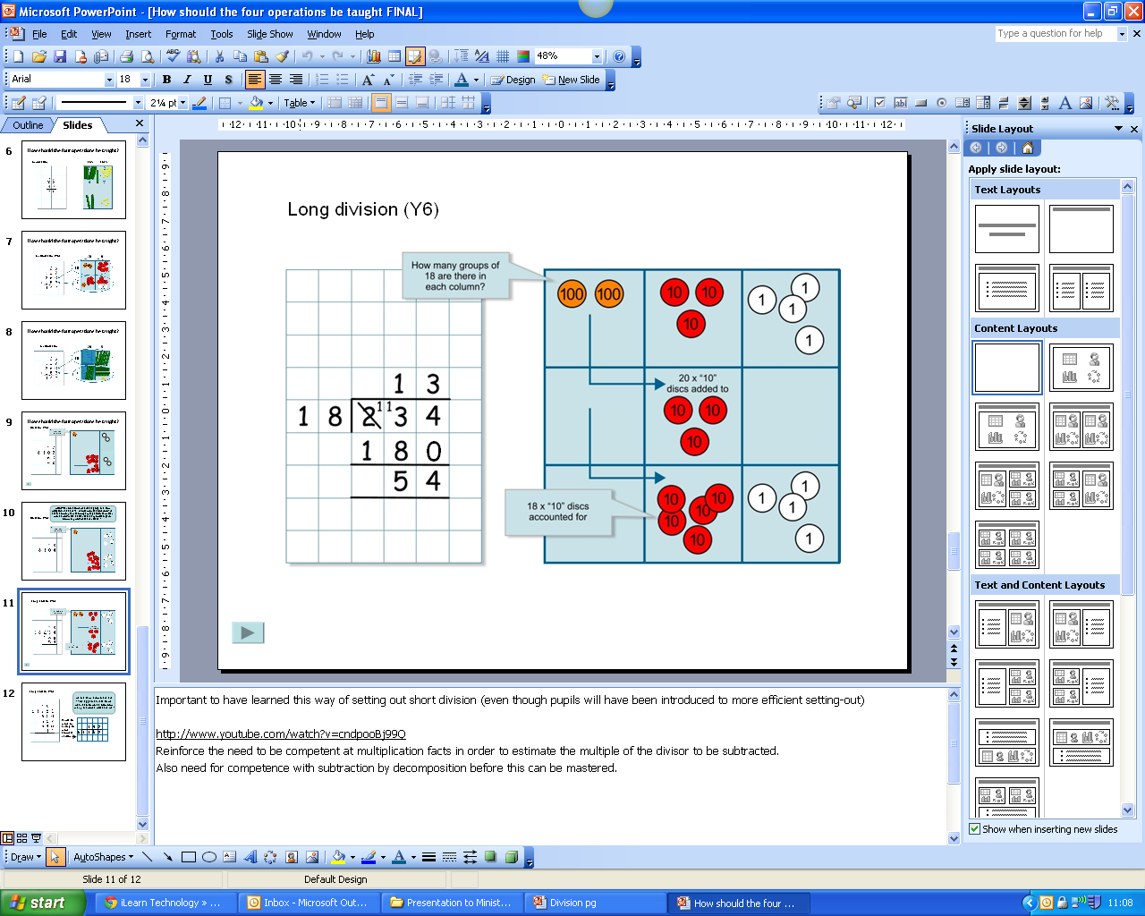
63 ⎟ 3
The power of the place value
counters for division
2
1
3
63
Year 3
Notes:
When there is a need to use the place value counters to represent larger numbers the removing of groups of 3 counters can be used to model dividing by 3 because removing 3 counters and placing them in an array is equivalent to sharing between three.
In this way larger number can be divided efficiently and this awareness is an important pre-cursor to the division algorithm introduced in the next slides.

Slide 6
Now try using your place value counters
to solve:
824 ÷ 2 =
What about when there is a remainder?
847 ÷ 4 =
Year 3 & 4

Slide 7
423 ⎟ 3
The power of the place value
counters for exchange:
1
4
1
exchange
3
423
1
Year 4
Notes:
When there is a need to use the place value counters to represent larger numbers the removing of groups of 3 counters can be used to model dividing by 3 because removing 3 counters and placing them in an array is equivalent to sharing between three.
In this way larger number can be divided efficiently and this awareness is an important pre-cursor to the division algorithm introduced in the next slides.

Slide 8
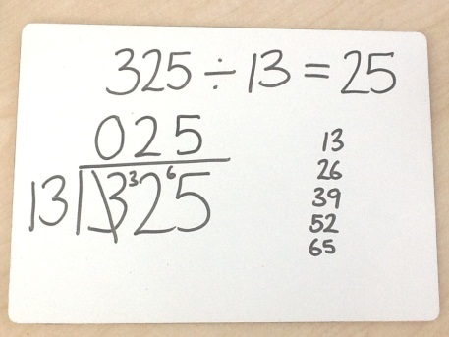
Moving away from place value counters:
325 ÷ 13 =
Year 4: No remainder
Year 5: With remainder

Slide 9
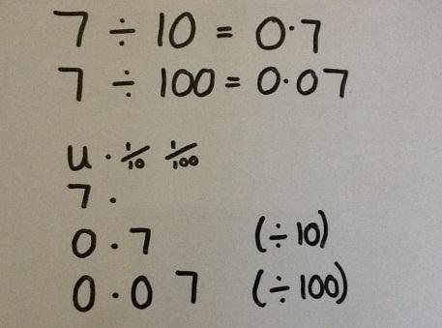
Dividing by 10 and 100:
The digits move around the decimal point.

Slide 10
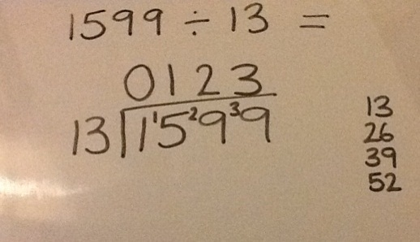
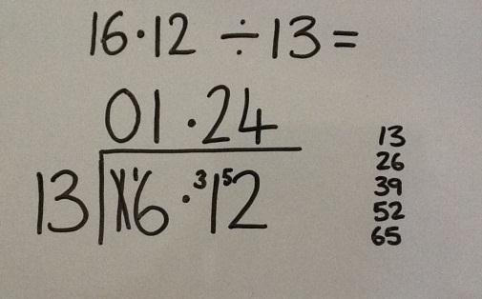
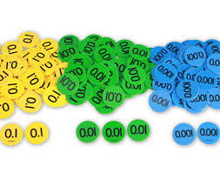
Divide numbers up to 4 digits by a two-digit whole number using the formal written
method of division:.
Year 6

Slide 11
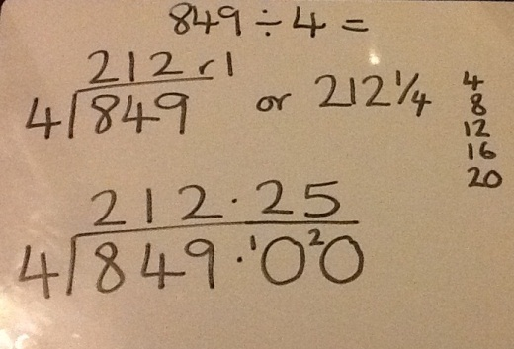
Interpret remainders as whole number remainders,
fractions or decimals.
Year 6

Slide 12
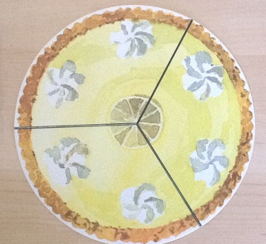
Divide proper fractions by
whole numbers:
¹/₃ ÷ 2 = ¹/₆
Year 6

Slide 13
Multiplication

Slide 14
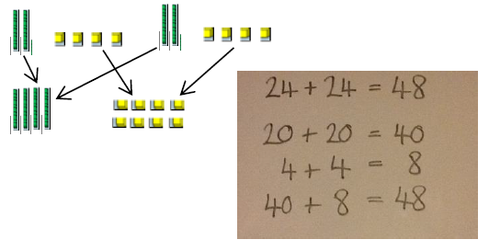
Children will learn to calculate doubles of 2-digit numbers through the use of partitioning.
Year 3

Slide 15
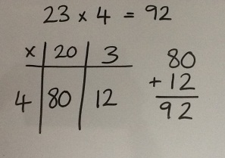
Children will be taught to multiply numbers (TO x O) through partitioning to understand the formal written method of grid multiplication.
Year 3

Slide 16
Now it’s your turn -
Can you solve 58 x 6 =

Slide 17
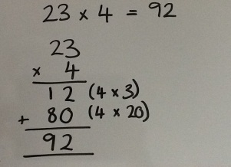
Children will be taught to multiply numbers (TO x O) using the formal written method of expanded column multiplication and make the link to grid method.
Moving from grid to a column method:
Year 3

Slide 18
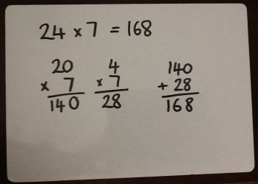
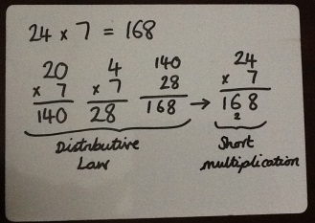
Children will be taught to multiply numbers (TO x O) by partitioning the 2-digit number and using two short multiplications along with addition to solve the problem (Distributive Law). This is then linked to short multiplication.
Moving from expanded to short multiplication:
Year 4

Slide 19
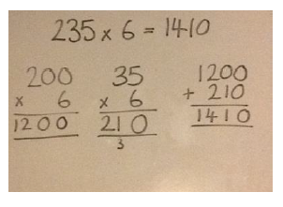
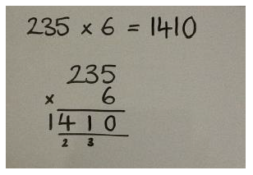
Children will move to multiply HTO by O, using Distributive Law and then moving on to short multiplication.
Moving from expanded to short multiplication:
Year 4

Slide 20
Now it’s your turn –
Solve this calculation using the distributive law
46 x 7 = or 123 x 6 =

Slide 21
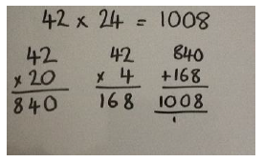
Children will be taught to multiply two 2-digit numbers by partitioning one number and using two short multiplications along with addition.
Year 5

Slide 22
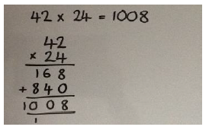
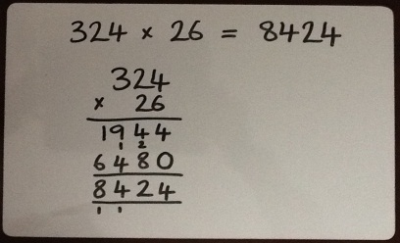
Children will be taught to multiply numbers using the formal method of long multiplication TO x TO then HTO x TO:
Then ThHTO x O and ThHTO x TO
Year 5

Slide 23
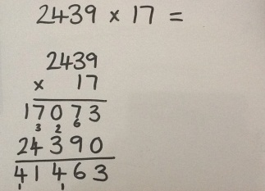
Multiply multi-digit numbers up to 4 digits by a 2-digit whole number using the formal written method of long multiplication.
Year 6

Slide 24
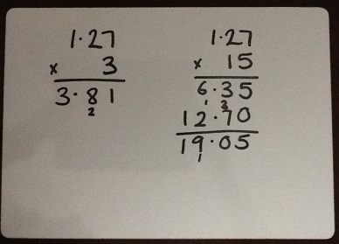
Multiply one-digit whole numbers with up to two decimal places by whole numbers using:
- Short multiplication when multiplying by a single digit whole number
- Long multiplication when multiplying by a 2-digit whole number
Year 6

Slide 25
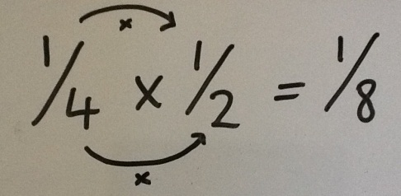
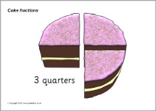
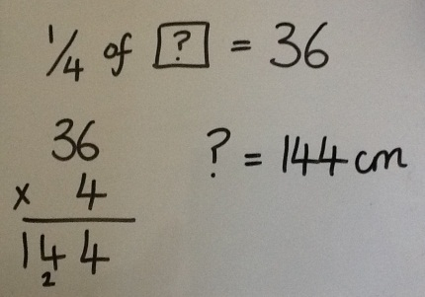
Models for multiplication with fractions
With the use of materials and diagrams, pupils will multiply proper fractions and mixed numbers by whole numbers.
Multiply simple pairs of fractions, writing the answer in its simplest form.
1
X 2 =
2
4
4
Year 4, Year 5 & Year 6

Slide 26
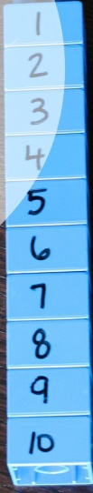


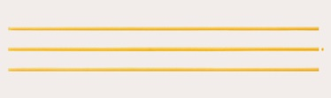
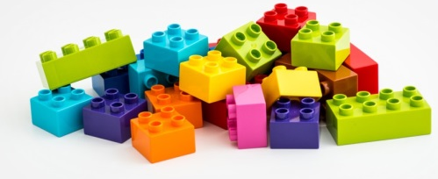
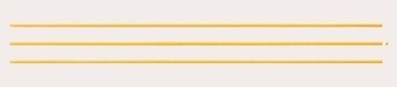
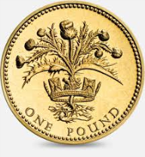
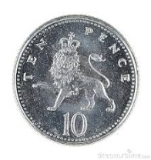
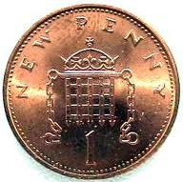
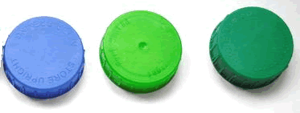
What can I use at home?
100
10
1

Slide 27

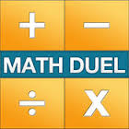


Useful apps and websites for calculation:
Maths Vs Zombies
Math Duel
TT Rock Stars
6 Numbers
www.topmarks.co.uk
www.mathplayground.com
www.crickweb.co.uk

